Slide 1
Comparison of “graphic” vs “clean” PET 4016/4032
DEC 142 GRAPHIC MODE
#define ENABLE_GRAPHIC_MODE printf("\x8E")
aka UPPER case
Had to use printf instead of cputc or cprintf
#define ENABLE_REVERSE_MODE printf("\x12")
#define ENABLE_REGULAR_MODE printf("\x92")
DEC 14 CLEAN MODE
#define ENABLE_CLEAN_MODE printf("\x0E")
aka LOWER case
Had to use printf instead of cputc or cprintf

Slide 2
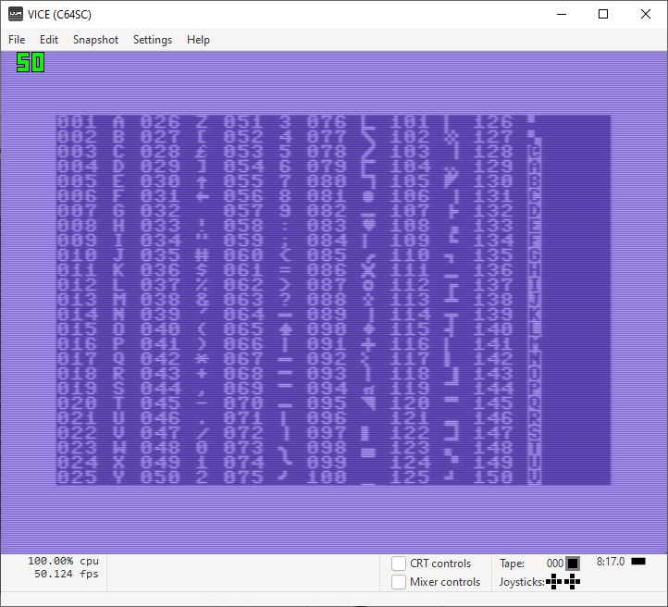
POKE(53272U,21)

Slide 3
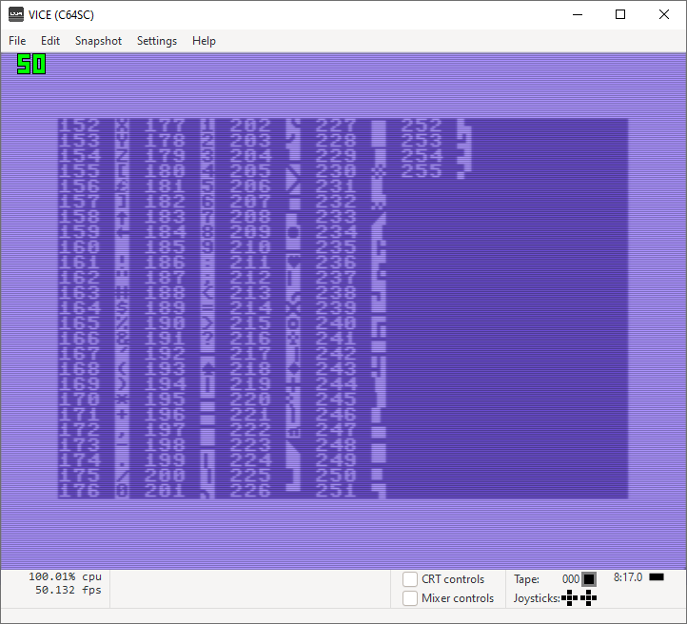
POKE(53272U,21)

Slide 4
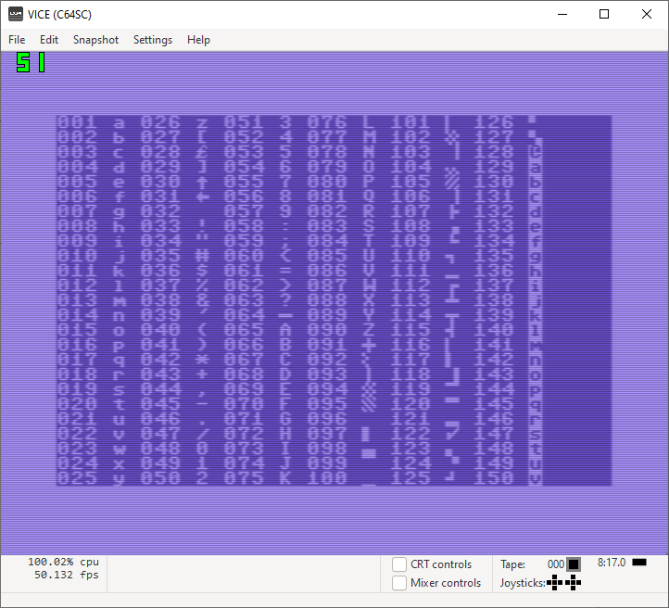
POKE(53272U,23)

Slide 5
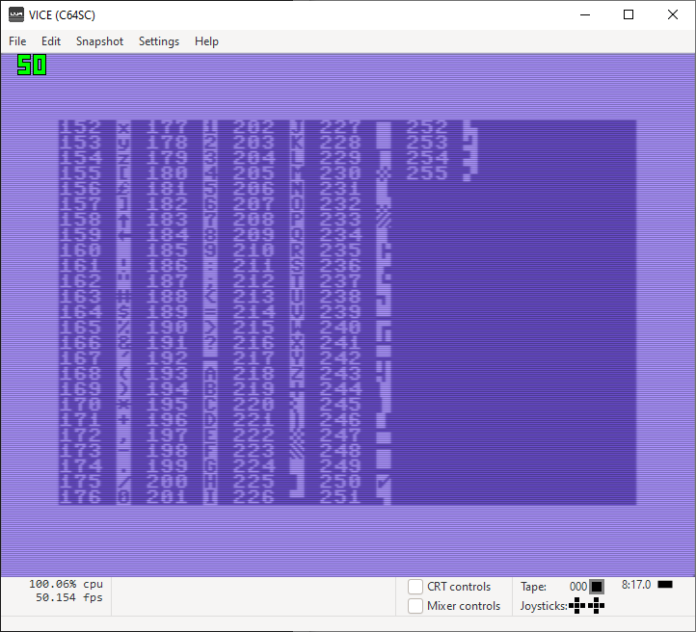
POKE(53272U,23)

Slide 6
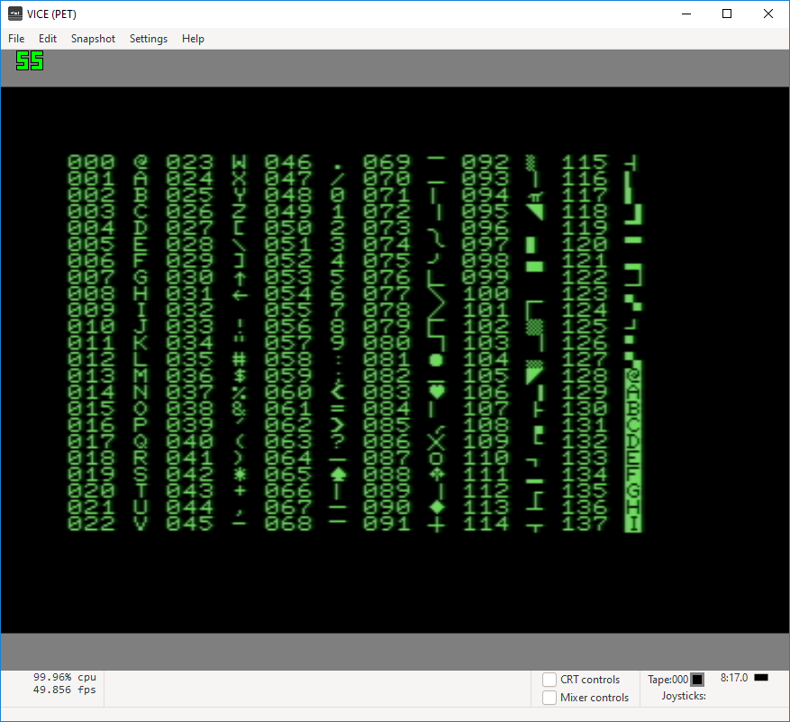
12
ENABLE_GRAPHIC_MODE;
POKEW(59468U,12);

Slide 7
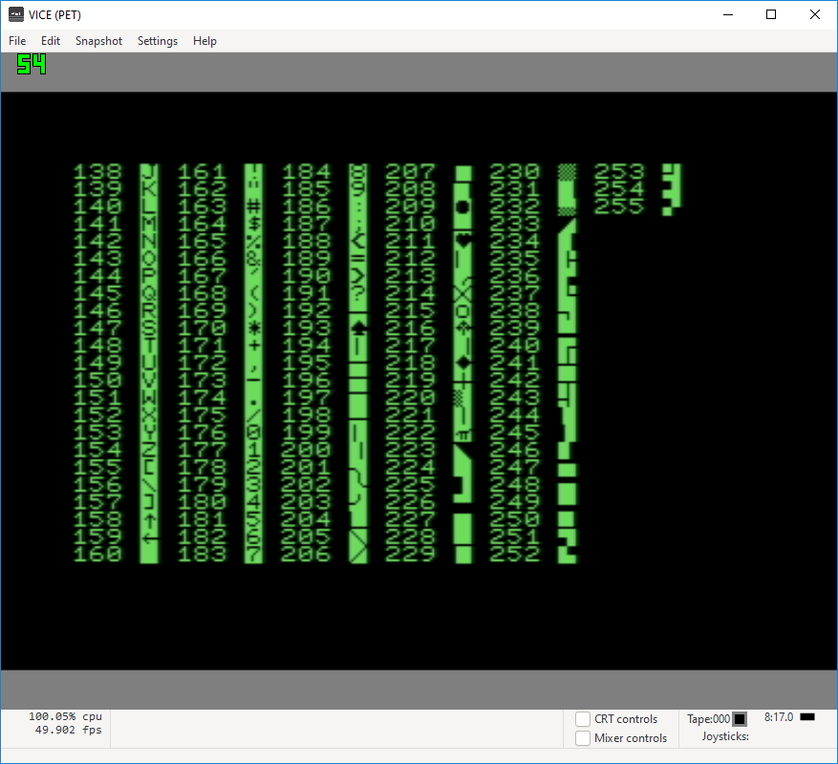
12
ENABLE_GRAPHIC_MODE;
POKEW(59468U,12);

Slide 8

14
ENABLE_GRAPHIC_MODE;
POKEW(59468U,14);

Slide 9
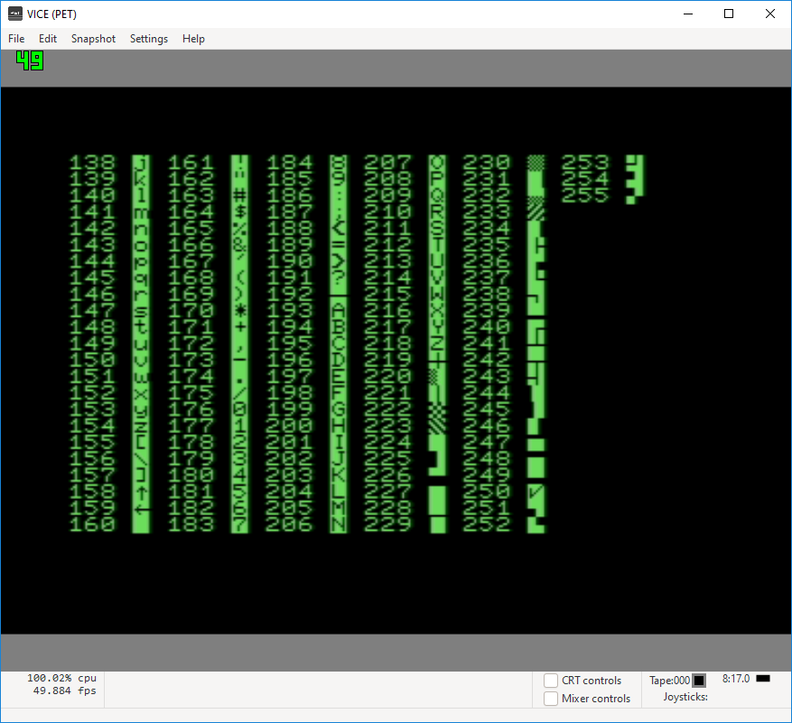
14
ENABLE_GRAPHIC_MODE;
POKEW(59468U,14);

Slide 11
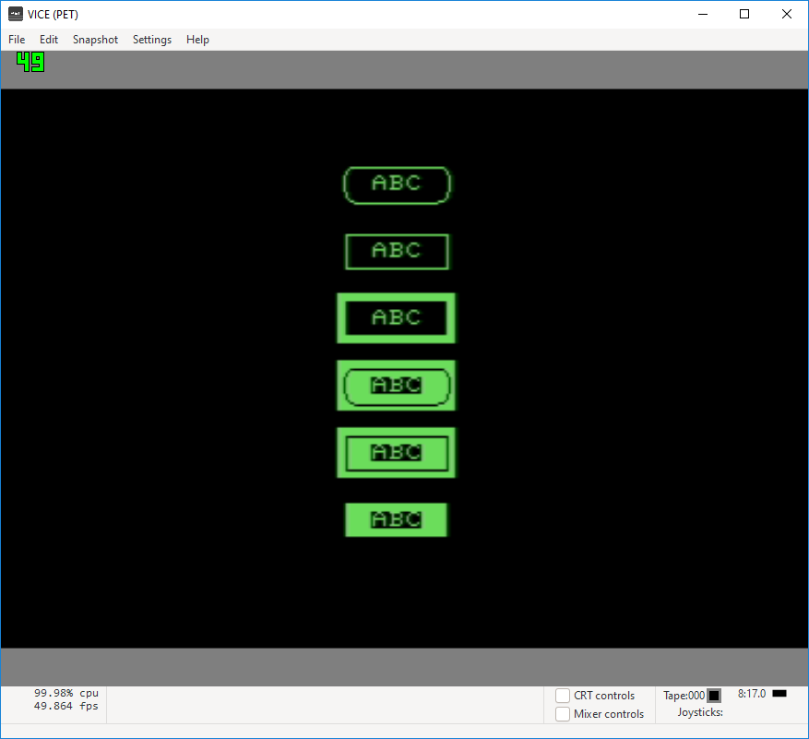

Slide 13
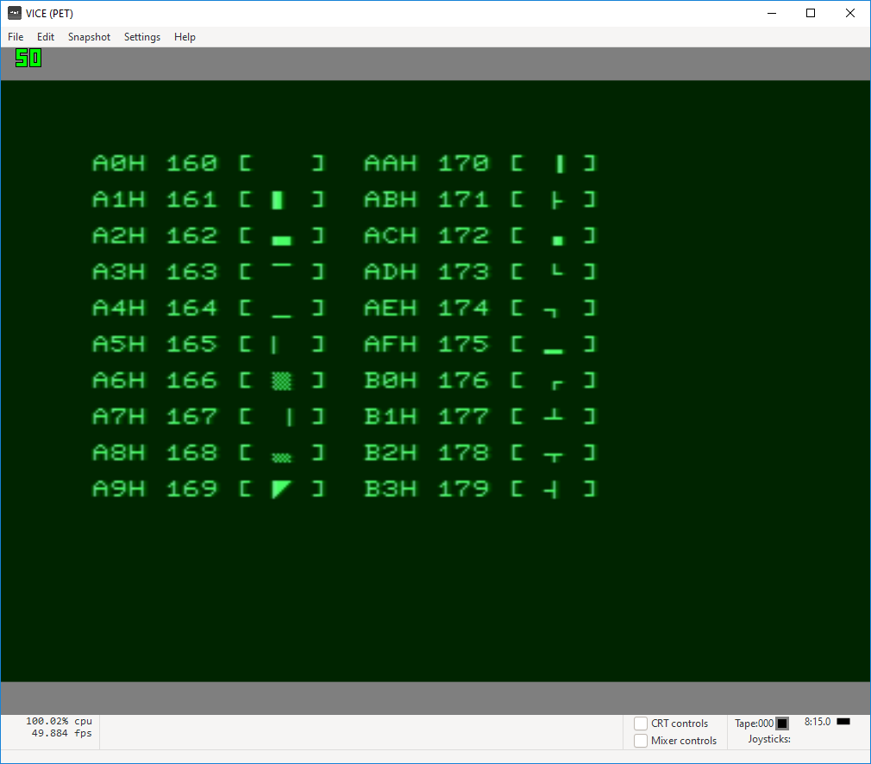
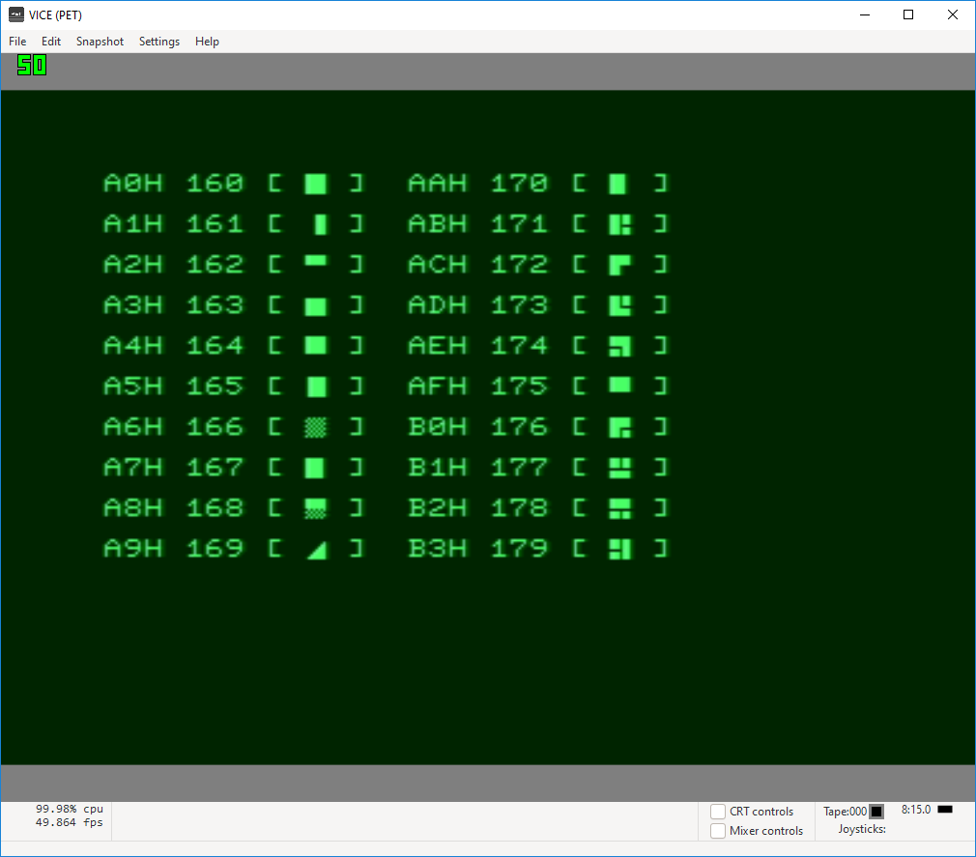
99
REGULAR (graphic mode)
REVERSE (graphic mode)

Slide 14
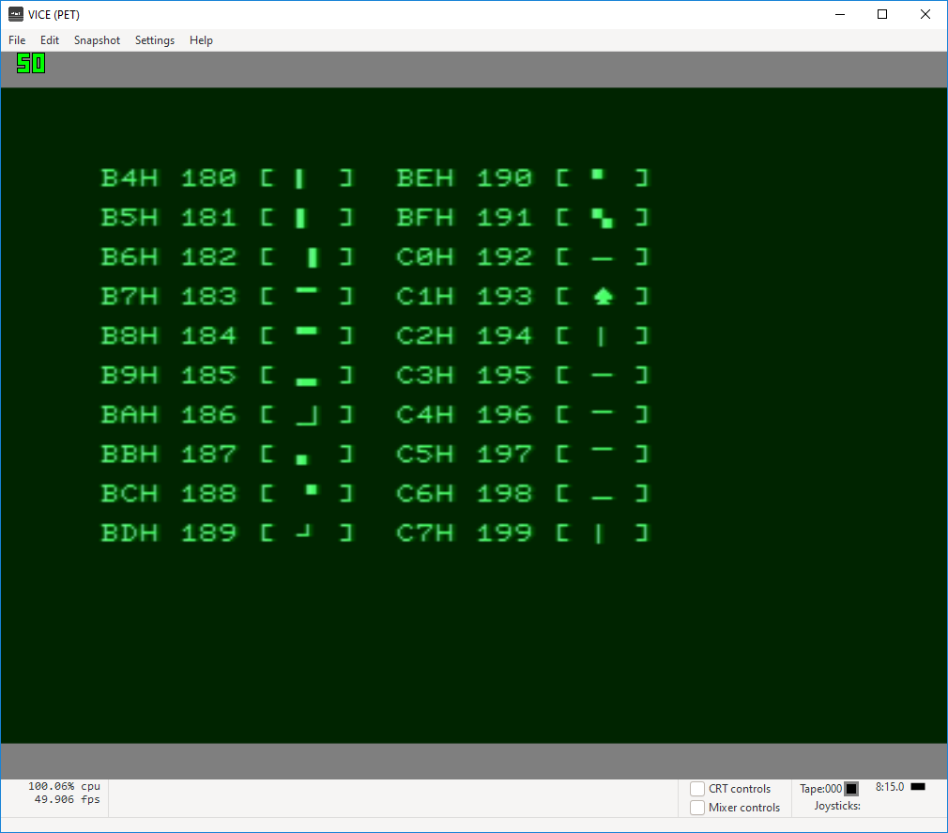
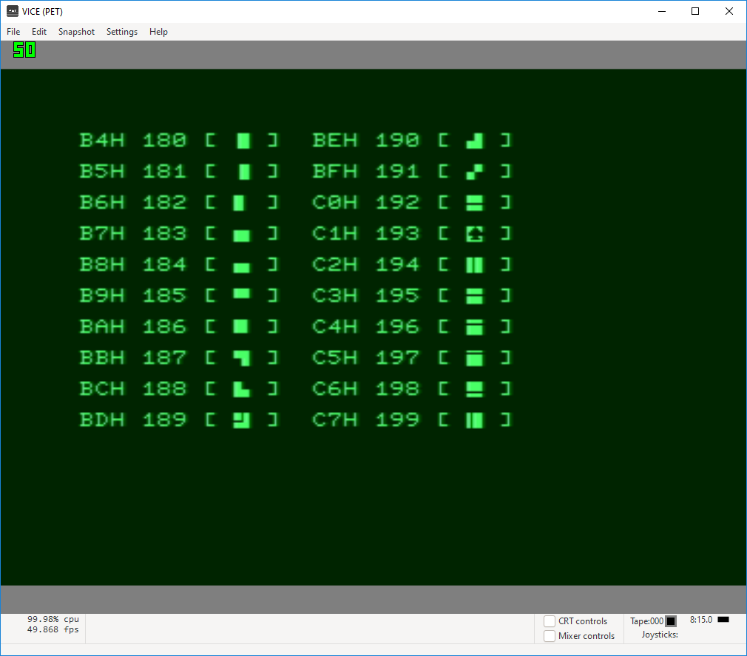
REGULAR (graphic mode)
REVERSE (graphic mode)

Slide 15
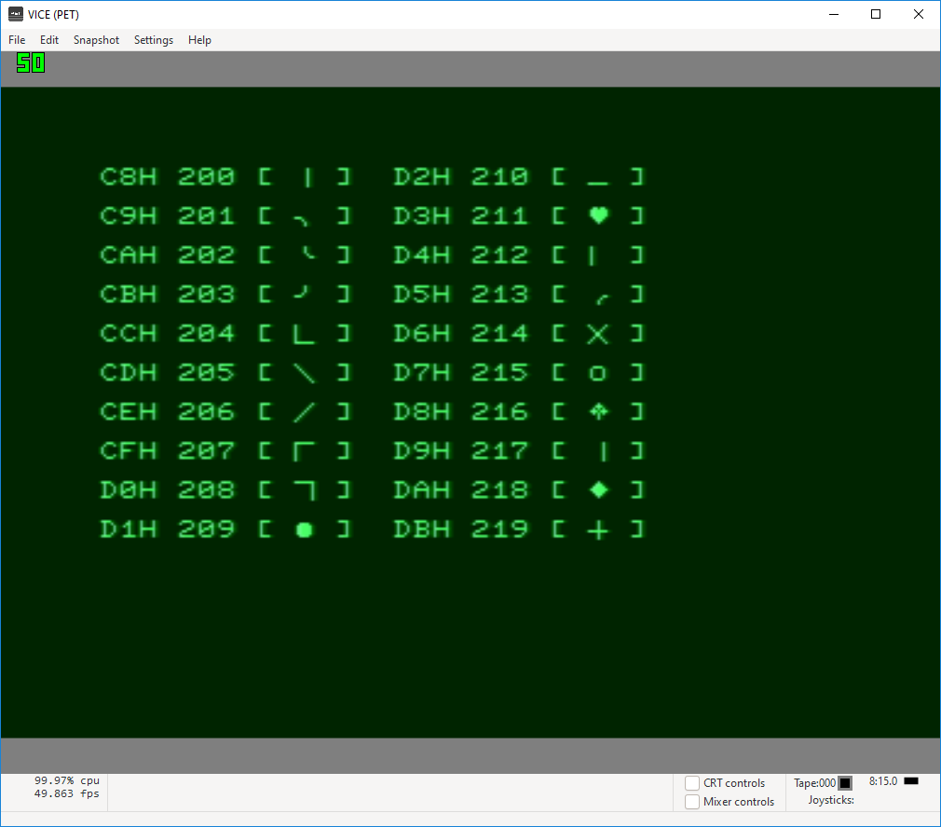
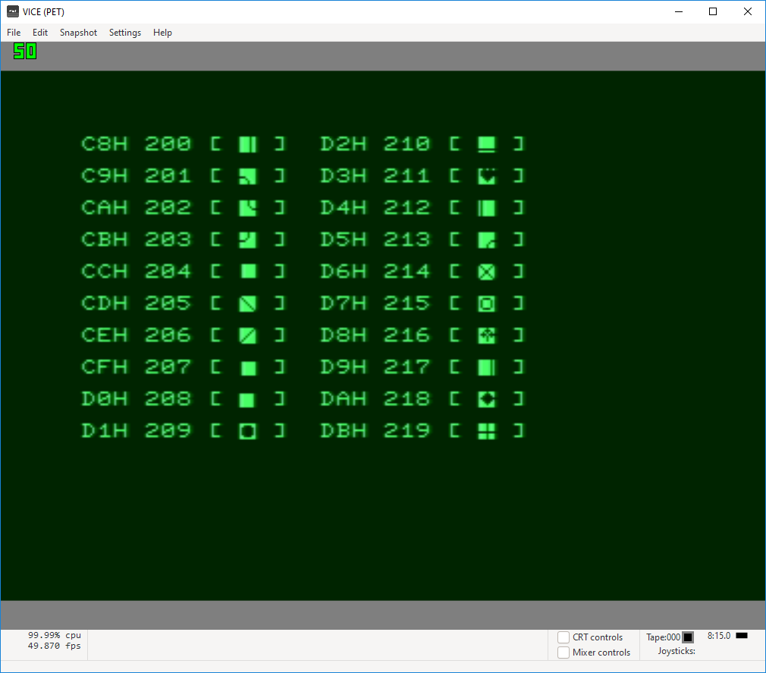
36
REGULAR (graphic mode)
REVERSE (graphic mode)

Slide 16
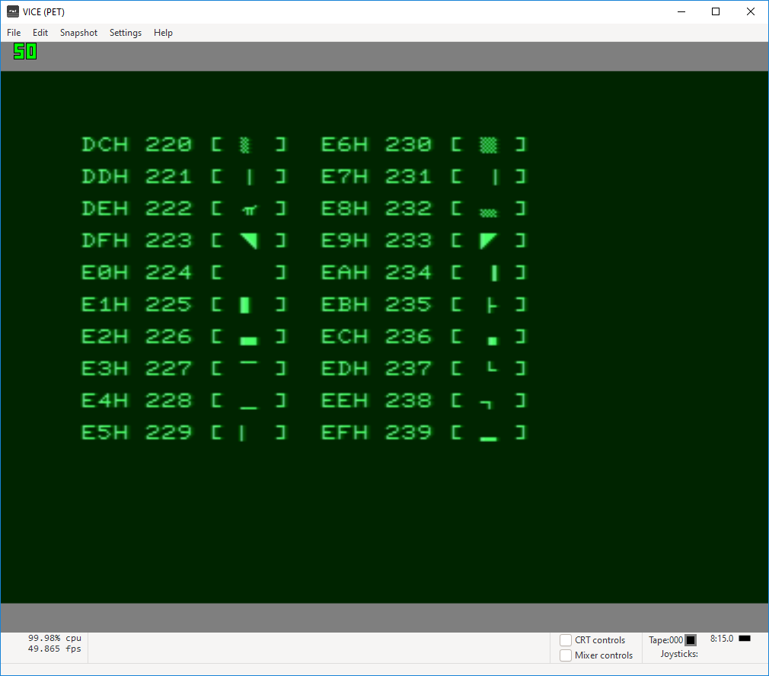
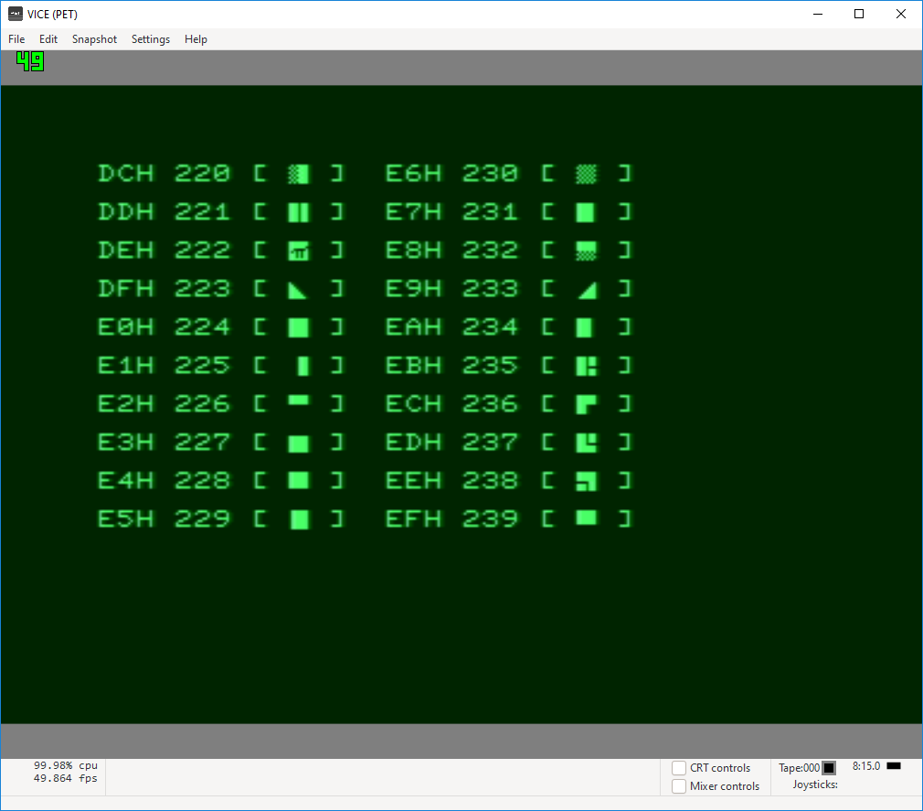
REGULAR (graphic mode)
REVERSE (graphic mode)

Slide 17
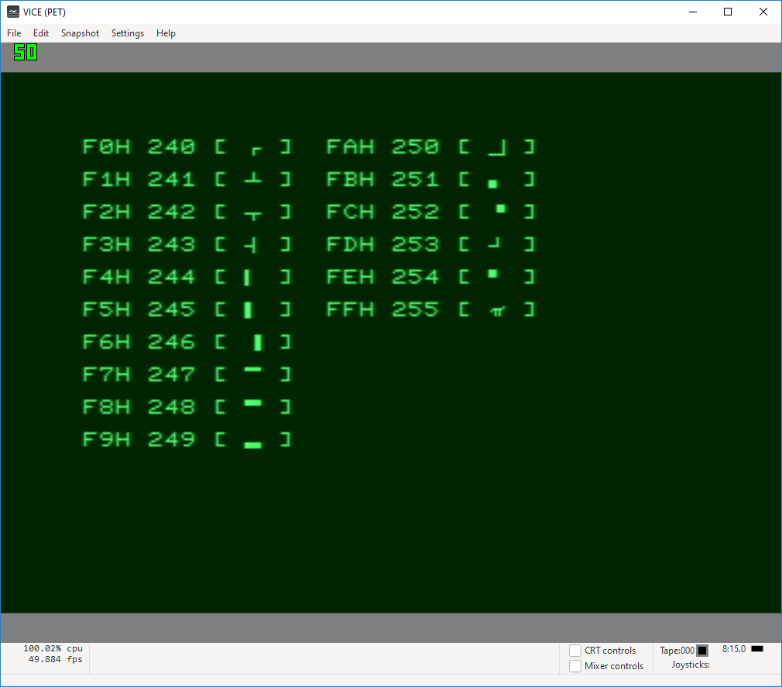
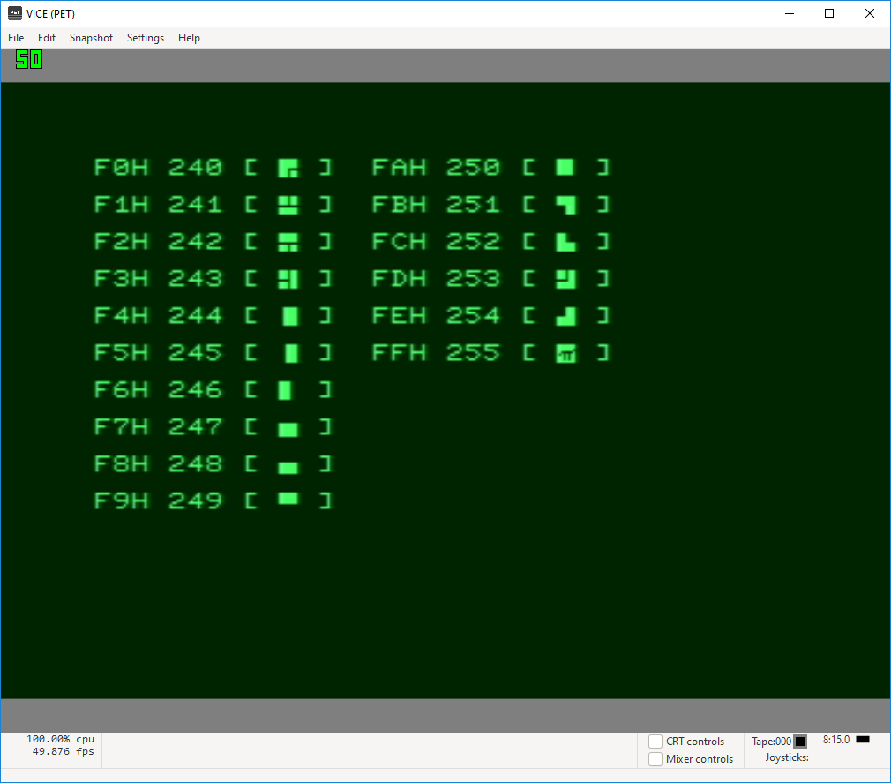
REGULAR (graphic mode)
REVERSE (graphic mode)

Slide 18
Next is a comparison…
“GRAPHIC MODE” on LEFT, “REGULAR MODE” on RIGHT
Note difference in text height
Focused on DECIMAL 160 and greater

Slide 19
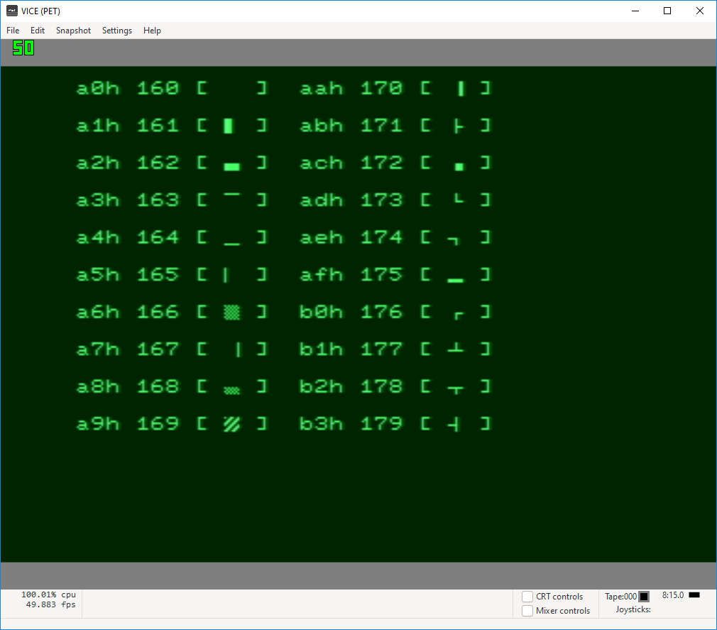

Slide 20
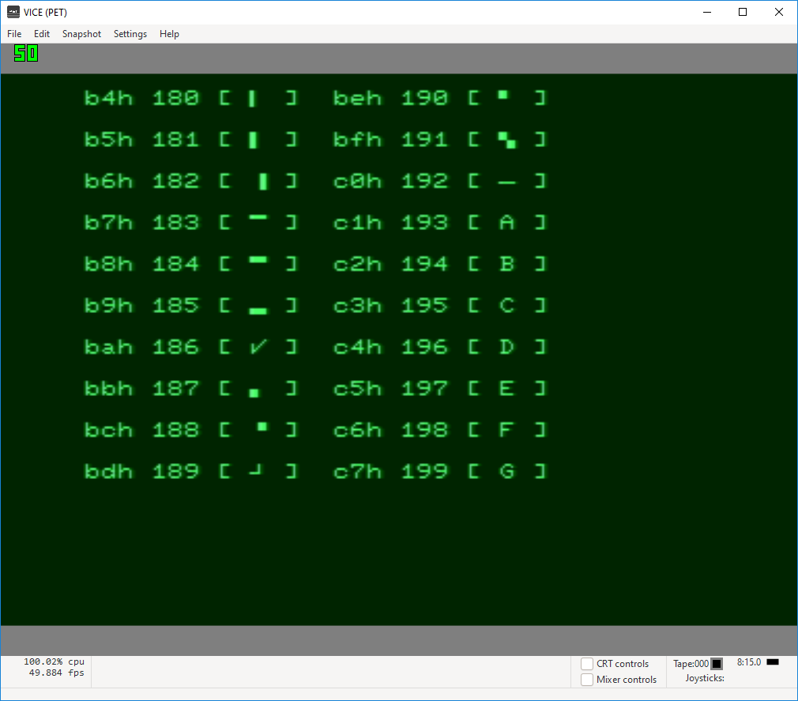

Slide 21
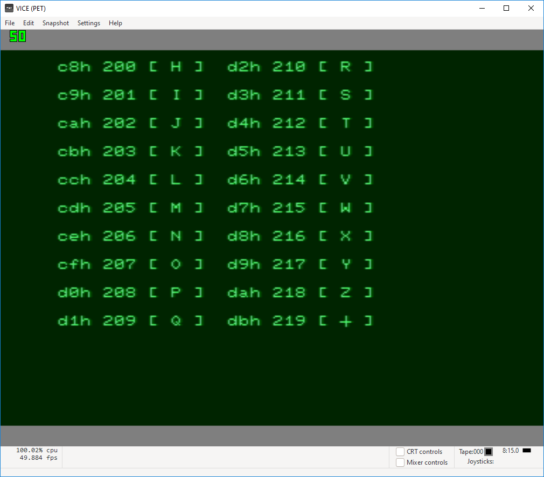

Slide 22
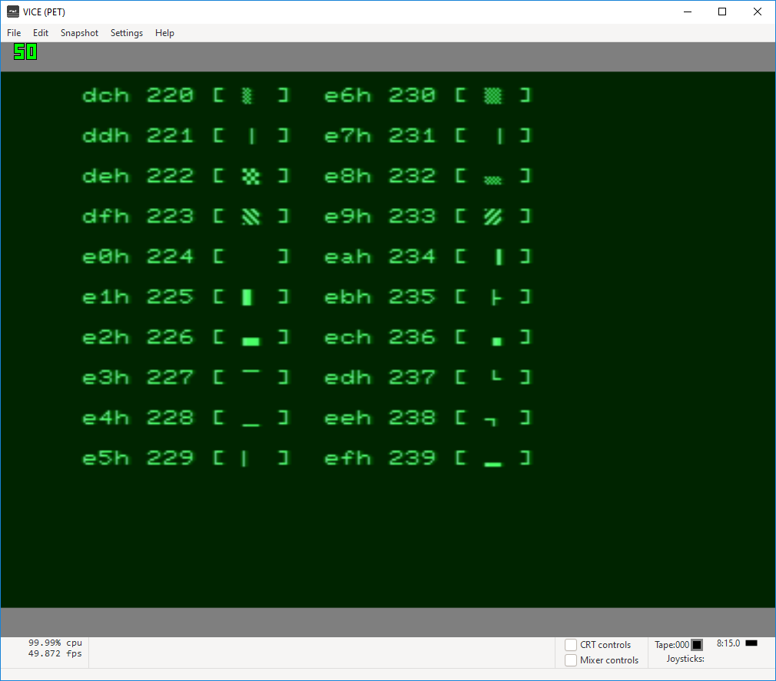

Slide 23
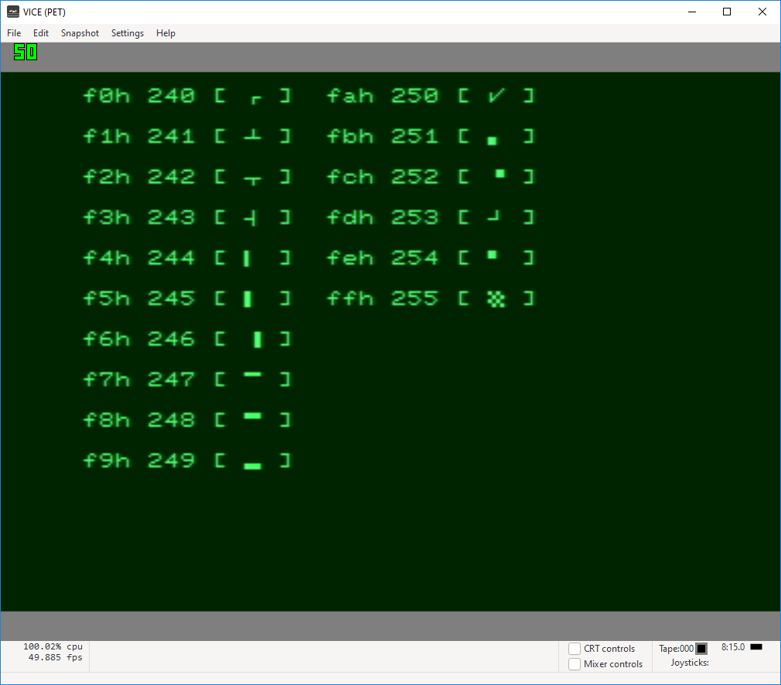

Slide 25
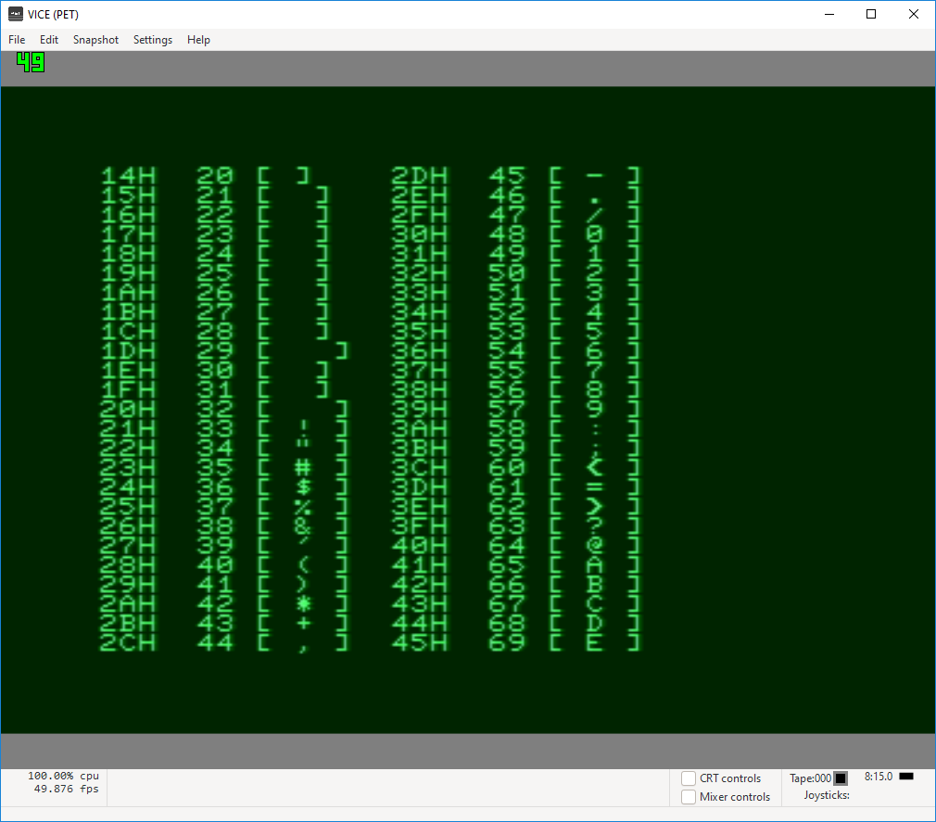
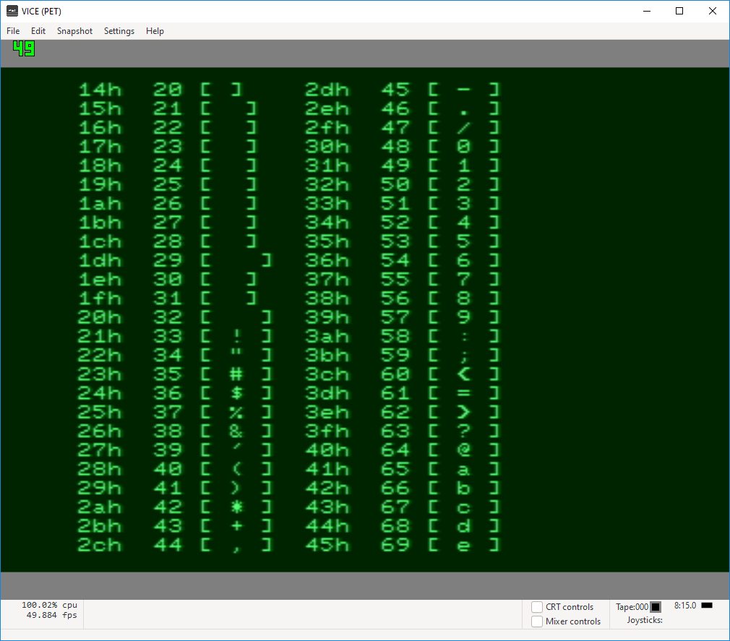

Slide 26
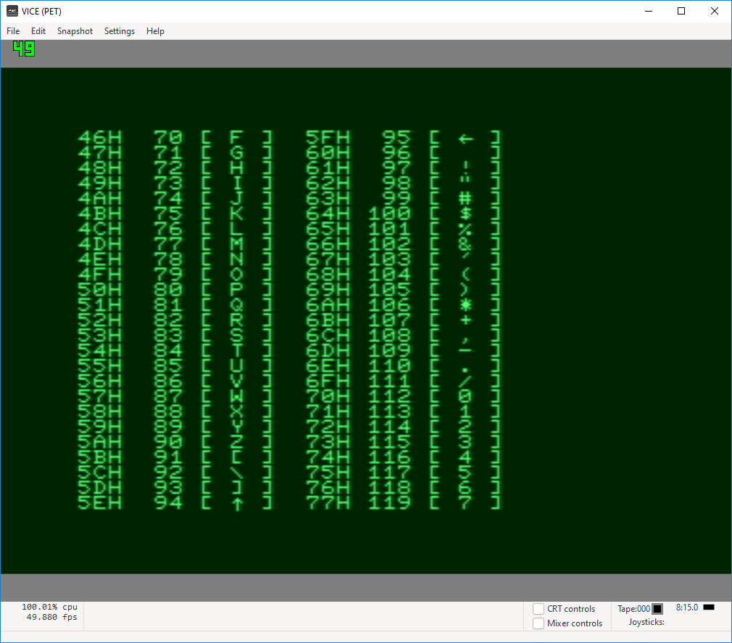
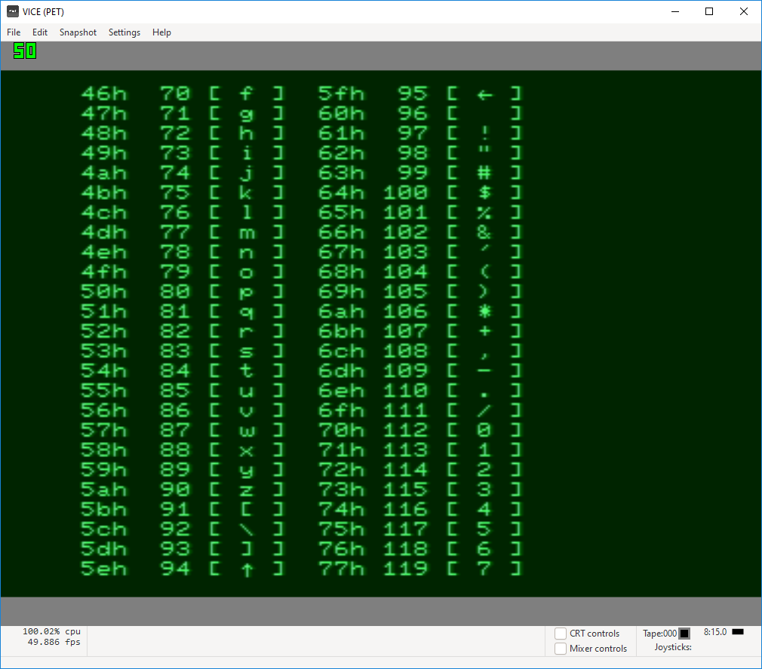

Slide 27
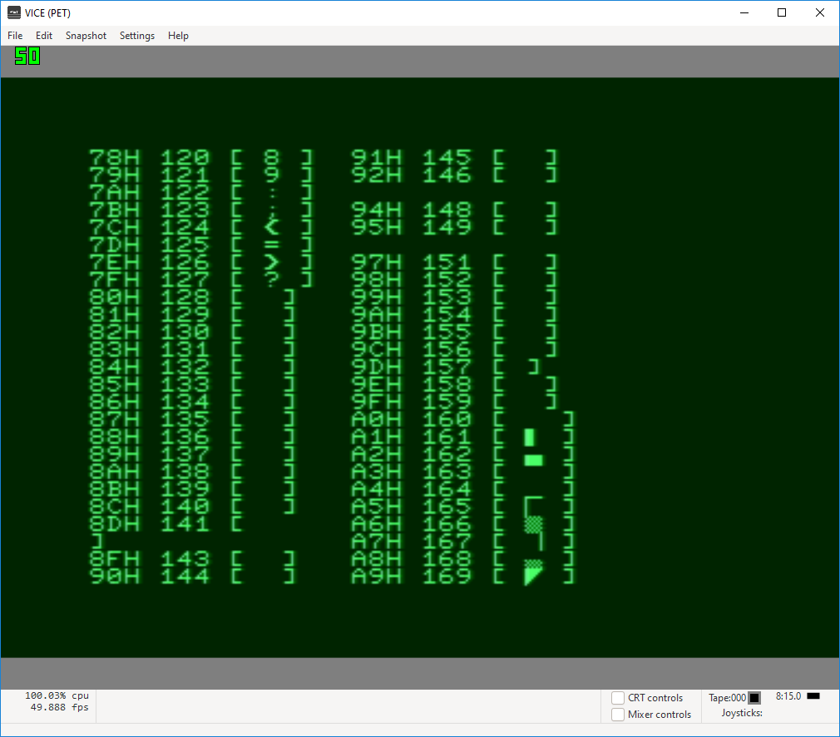
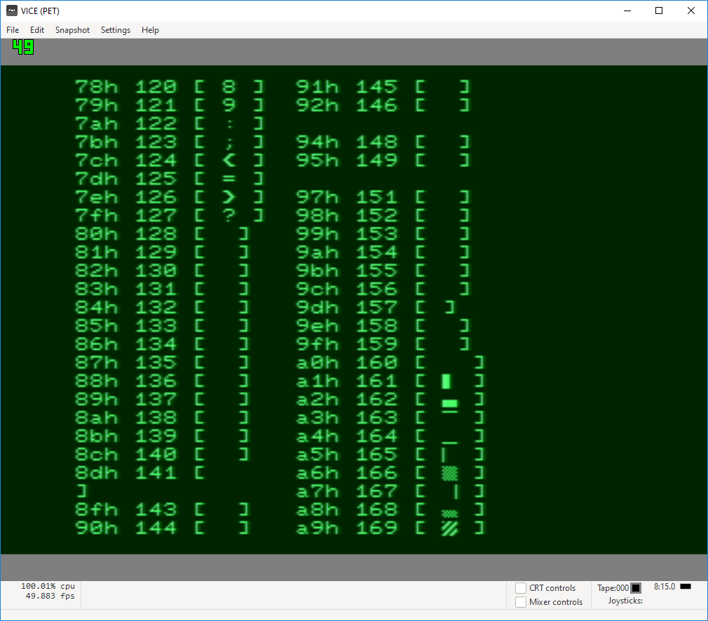

Slide 28
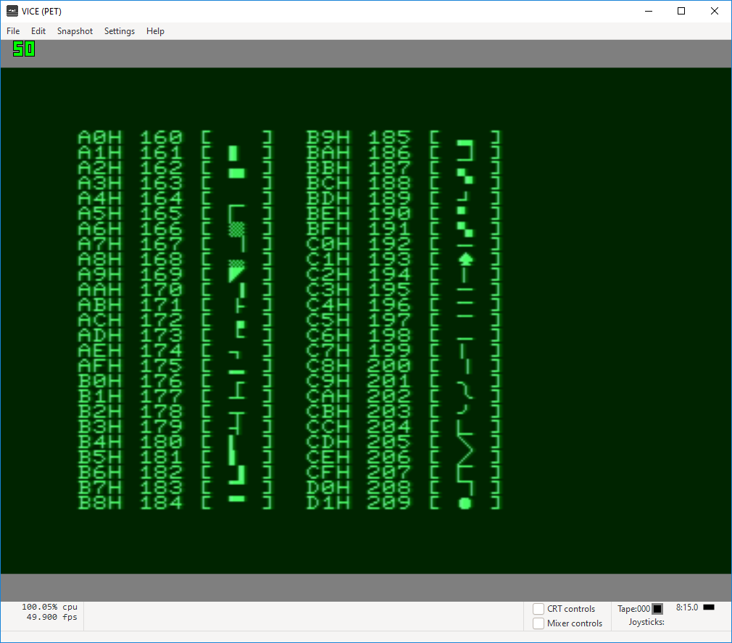
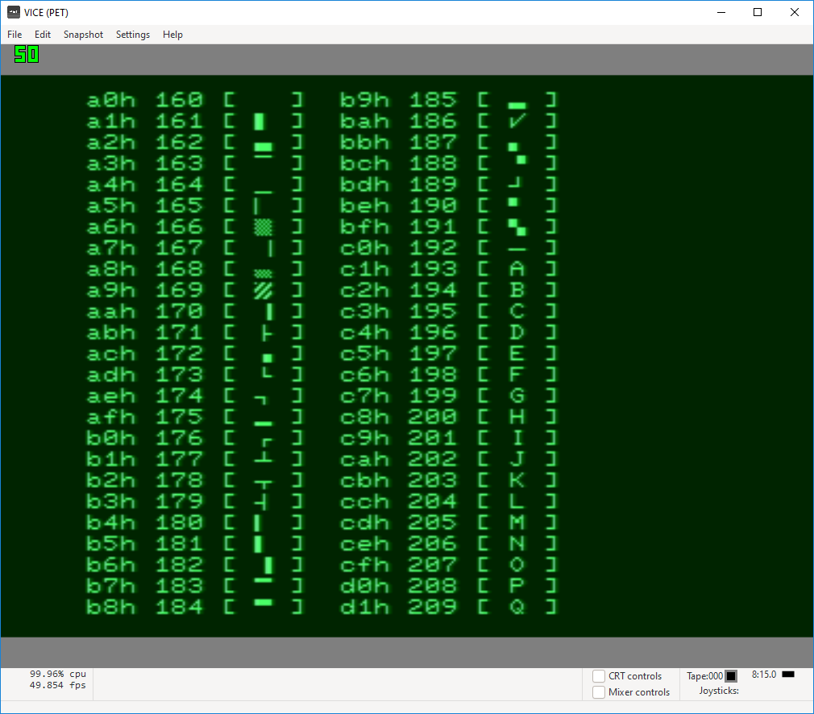

Slide 29
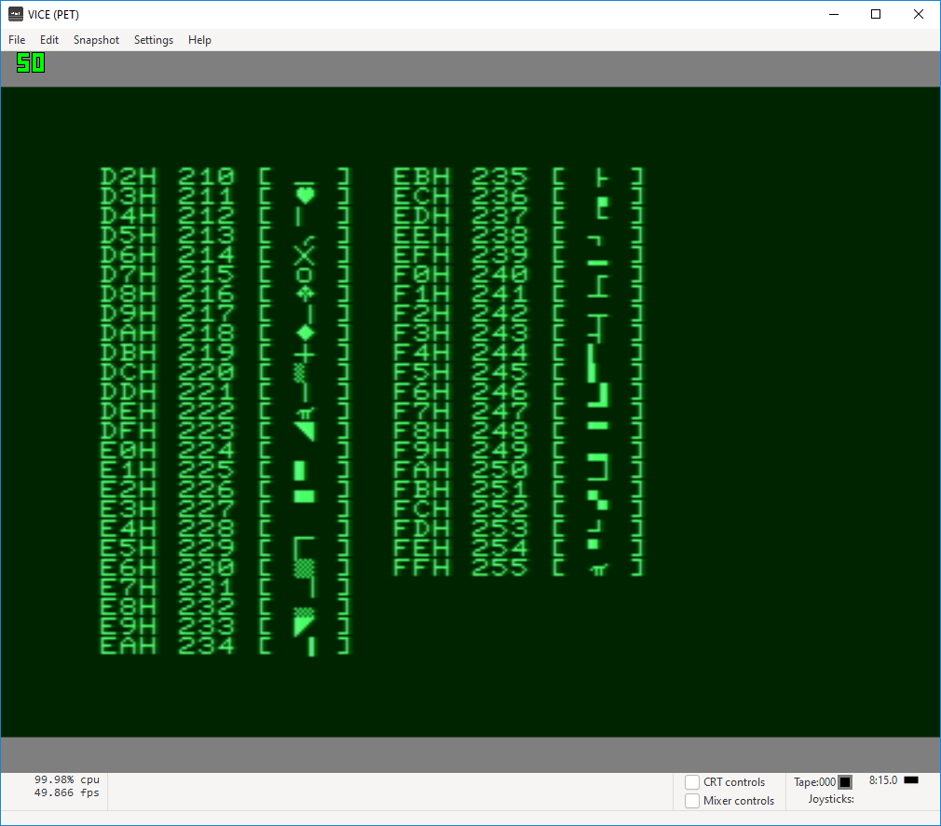
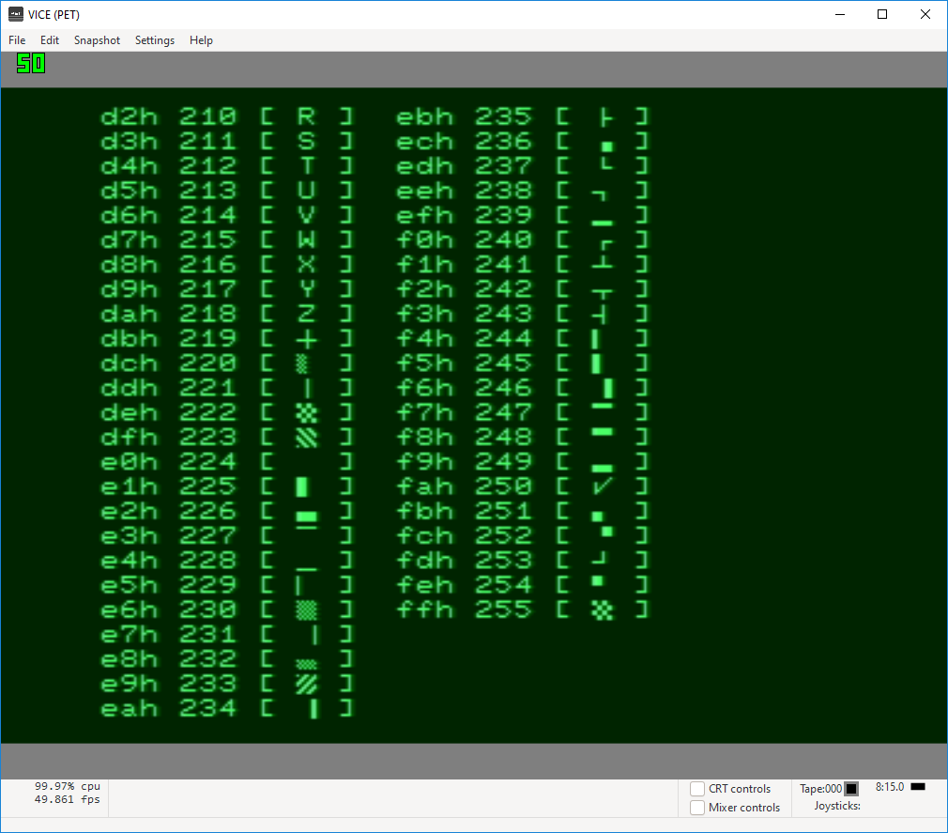

Slide 30
Example of “graphic” mode and “reverse”
Looks like Egyptian hieroglyphs

Slide 31
Performance Strategies for C
while (n > 0) { (do-stuff); --n; }
Use table data (for symbols), minimize use of switch
Balance use of macros vs functions
rand_mod function instead of % all-over
No use of conio, stdio
Functions only for exactly what is needed
Use of system calls
Clrscr
Minimum calls to strlen, use #define LEN macro instead

Slide 32
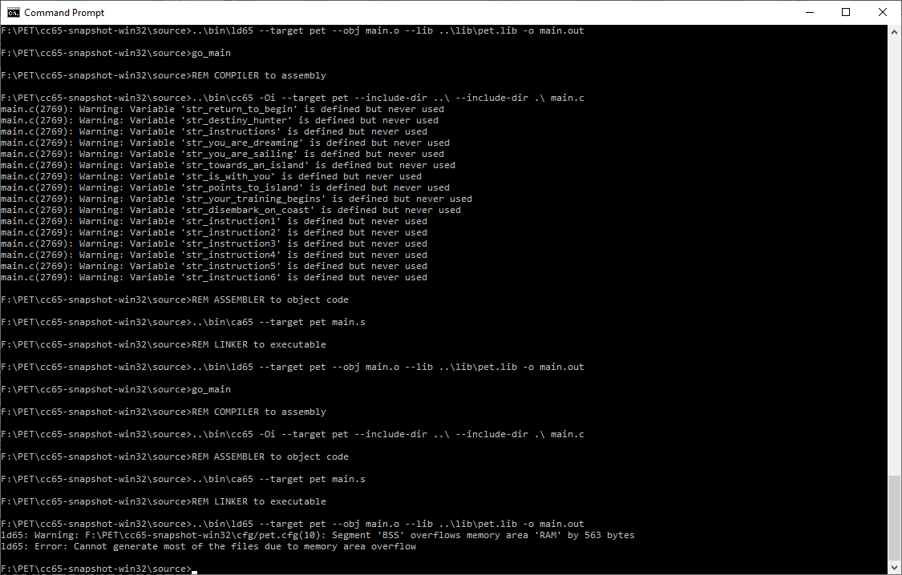

Slide 33
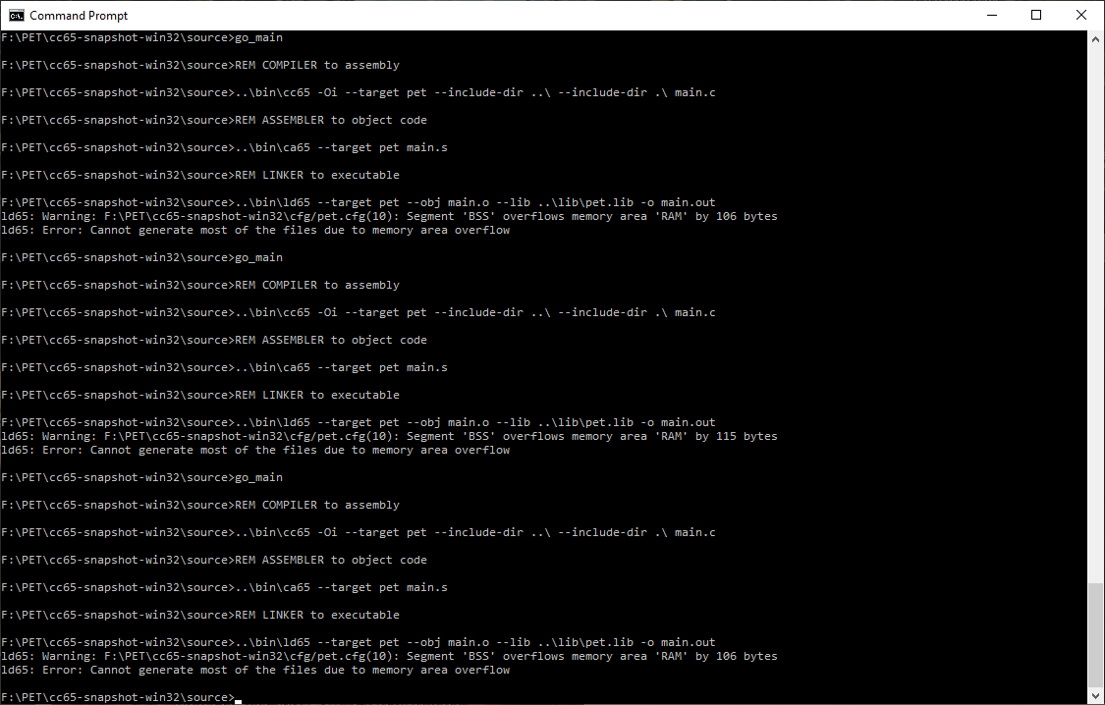

Slide 34
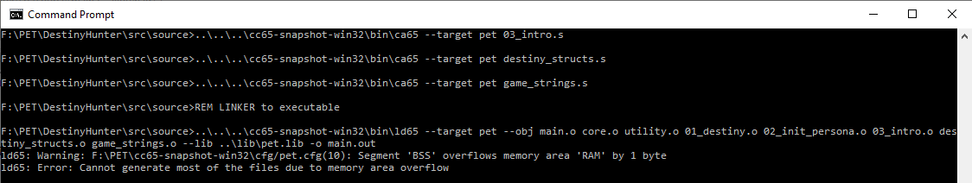

Slide 35
F:\PET\cc65-snapshot-win32\source>..\bin\ld65 --target pet --obj main.o --lib ..\lib\pet.lib -o main.out
ld65: Warning: F:\PET\cc65-snapshot-win32\cfg/pet.cfg(10): Segment 'BSS' overflows memory area 'RAM' by 106 bytes
ld65: Error: Cannot generate most of the files due to memory area overflow

Slide 36
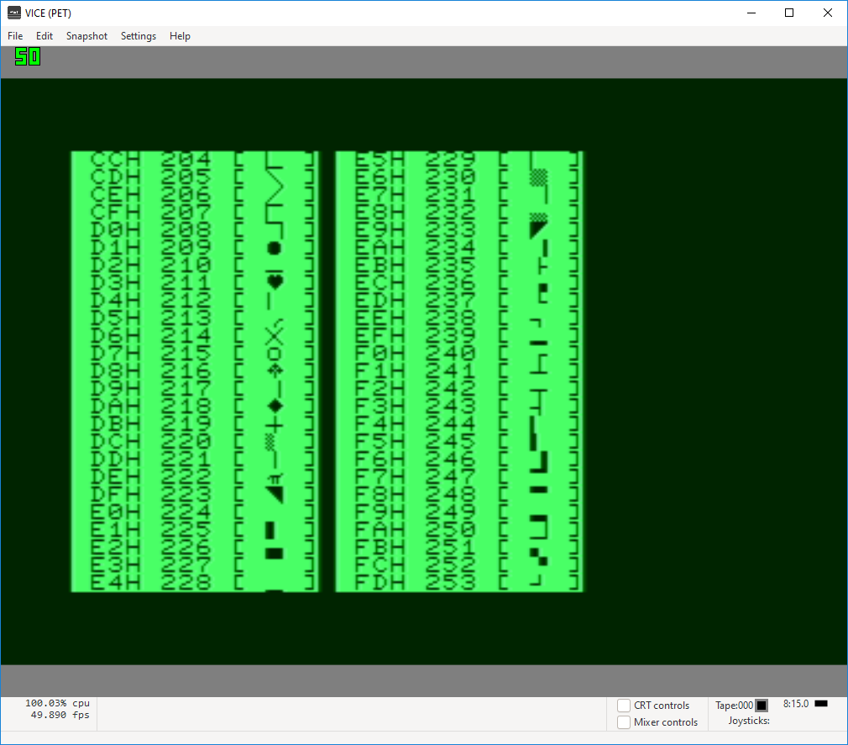

Slide 37
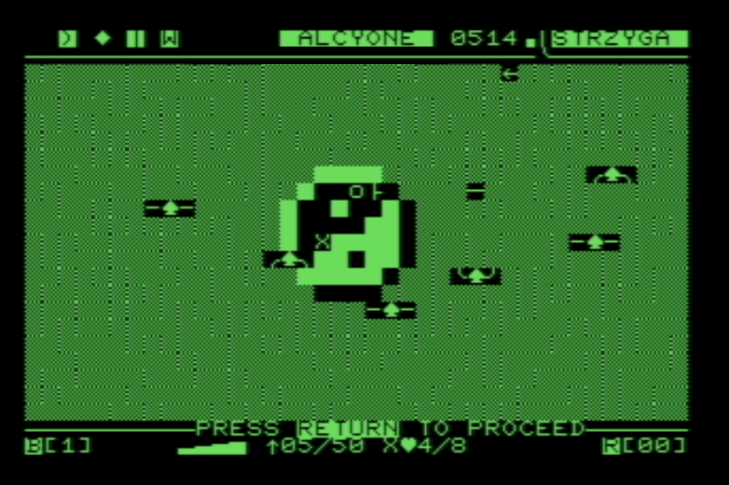
inventory
divinity island
(surrounded by water)
drop from a kill
arrow in flight

Slide 38
